Slide 1

International Year of Forests
Art Competition 2011
High School Submissions

Slide 2
Thank-you!!!
Fundy Model Forest thanks all who entered pieces in this contest and are very pleased to exhibit your entries here.
Many of you provided artist statements which illuminate the work for the viewer. These are included.

Slide 3
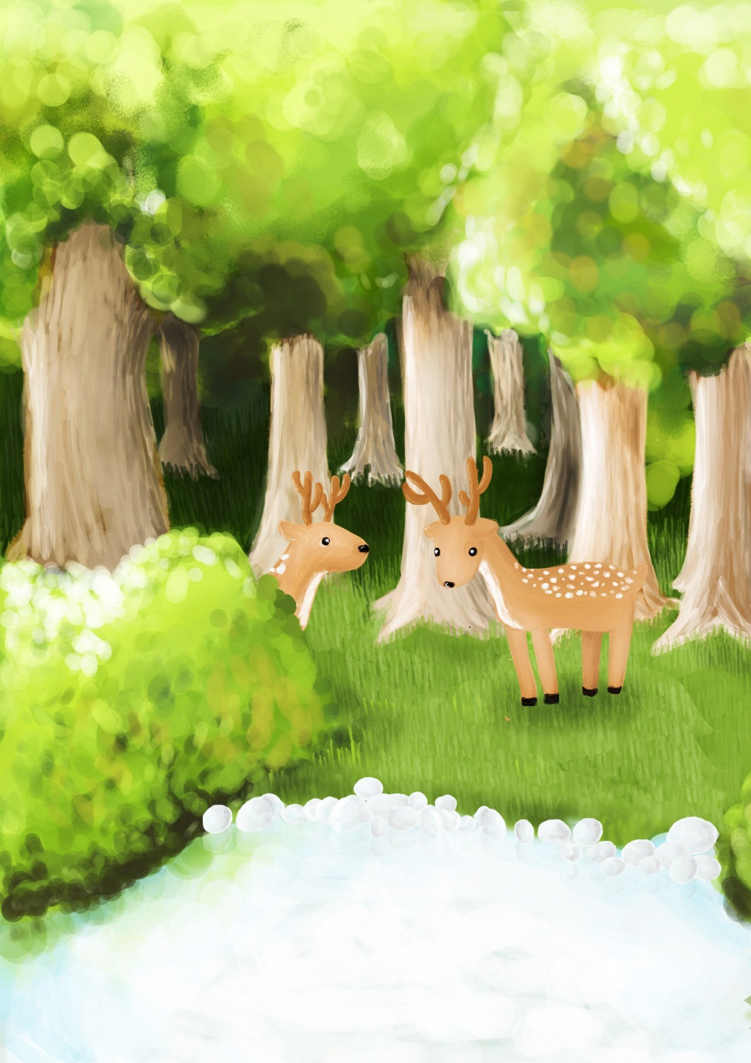
Deer in Forest
Heeyoung Park
Grade 11
St. Malachy’s Memorial High School
Saint John, N.B>

